Slide 1
Recording the Beatles
Music 1104
Week 01-01 Introduction
Professor Mountain

Slide 2
Recording the Beatles
Classroom: B-120
Class hours: Tues. Thurs. 9:35-10:50
Prof. Toby Mountain
tm@northeasterndigital.com
Office hours: Tues. 11:00am-1:30pm
Syllabus and weekly assignments posted on Blackboard at www.tobymountain.com/teaching.
Introductions

Slide 3
Requirements
Weekly readings
Weekly listening
4 unannounced quizzes (based on reading/listening)
Writing Assignment: short paper (1,000 words)
Midterm / Final Exam
Active class participation – important to boost your grade
Final Exam 30%, Midterm Exam 25%, 4 Unannounced Quizzes 20%, Writing Assignment 15%, Class Participation 10%.

Slide 4
Readings
“The Complete Beatles Recording Sessions”
Mark Lewisohn
Hamlyn Publishing, EMI
2018
ISBN-13: 978-0600635611
Required

Slide 5
Readings
“Here, There and Everywhere: My Life Recording the Music of the Beatles”
Geoff Emerick
Avery Publishing, 2007
ISBN-13: 978-1592402694
Not required - Assigned excerpts available on Blackboard

Slide 6
Readings
“All You Need is Ears”
George Martin
St. Martin's Griffin, 1994
ISBN-13: 978-0312114824
Not required - Assigned excerpts available on Blackboard

Slide 7
Readings
“Recording the Beatles”
Brian Kehew, Kevin Ryan
Curvebender Publishing; First Edition edition, 2006
ISBN-13: 978-0978520007
Not required - Assigned excerpts available on Blackboard

Slide 8
Readings
“The Beatles – The Ultimate Recording Guide”
Allen J. Wiener
Checkmark Books, 1992
ISBN-13: 9780816025114
Not required - Assigned excerpts available on Blackboard

Slide 9
Schedule - weeks 1-3
Week 1 Introduction
1962 – Hamburg Germany
Week 2 Early Beginnings - Liverpool
Week 3 First EMI Recordings

Slide 10
Schedule - weeks 4-5
Week 4 Please Please Me
With the Beatles
Week 5 A Hard Day’s Night
Beatles for Sale

Slide 11
Schedule - weeks 6-9
Week 6 Help!
Rubber Soul
Week 7 Revolver

Slide 12
Schedule - weeks 08-09
Week 8 Sgt. Pepper’s Lonely Hearts Club Band
Week 9 FALL BREAK / MIDTERM

Slide 13
Schedule - weeks 10-12
Week 10 Magical Mystery Tour
Week 11 The White Album
Week 12 Singles: Lady Madonna, Hey Jude; Writing Assignment

Slide 14
Schedule - weeks 13-14
Week 13, 14 Abbey Road
Week 14 Yellow Submarine
Thanksgiving Break

Slide 15
Schedule - weeks 15-16
Week 15 Let it Be
Week 16 FINAL EXAM

Slide 16
Assignment for Thursday
Available at tobymountain.com/teaching if necessary
Read “McCartney Interview” p. 6-15 from Lewison textbook “The Complete Beatles Recording Sessions”
Listen to these songs (at least 2x each):
I Want to Hold Your Hand” • “I’ll Follow the Sun” • “A Day in the Life” • “Abbey Road Medley” • “Get Back”

Slide 17
Question
How were records made in 1962 compared to today?
Differences in equipment?
Differences in recording process?
Differences in mastering (preparation of final release)?
Differences in manufacturing/distribution?

Slide 18
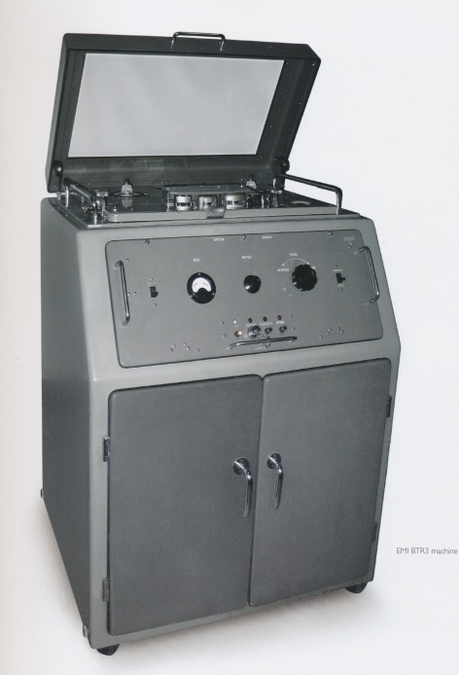
Question
How were records made in 1962 compared to today?
Differences in equipment/recording process?

Slide 19
Question
How were records made in 1962 compared to today?
Differences in mastering?

Slide 20
Question
How were records made in 1962 compared to today?
Differences in manufacturing/distribution?

Slide 21
Sources
“The Complete Beatles Recording Sessions” by Mark Lewisohn (Author), Paul McCartney (Introduction), Hamlyn Publishing Group, EMI, 1988, ISBN-13: 978-0600635611
“Here, There and Everywhere: My Life Recording the Music of the Beatles” by Geoff Emerick, (2007), ISBN-13: 978-1592402694
“All You Need is Ears” by George Martin, St. Martin's Griffin, 1994, ISBN-13: 978-0312114824
“Recording the Beatles” Brian Kehew, Kevin Ryan, Curvebender Publishing; First Edition edition (2006), ISBN-13: 978-0978520007
“The Beatles: The Ultimate Recording Guide” by Allen J. Wiener, Checkmark Books, 1992, ISBN-13: 978-0816025114

